Slide 1
Cybercrime: Mobile and Wireless Devices UNIT - 2

Slide 2
Unit 2: Learning Objectives
Understand the security challenges presented by mobile devices and information systems access in the cybercrime world.
Understand challenges faced by the mobile workforce and implication under the cybercrime era
Mitigation strategy – credit card users.
Security issues due to use of media players
Organizational security implications with electronic gadgets
Organizational measures for protecting information systems from threats in mobile computing area.
Smishing, vishing attacks in mobile world.
Security issues arising due to use of removable media- pen drives

Slide 3
Proliferation of mobile and wireless devices
You see them everywhere: people hunched over their smart phones or tablets in cafes, airports, supermarkets and even at bus stops, seemingly oblivious to anything or anyone around them.
They play games, download email, go shopping or check their bank balances on the go.
They might even access corporate networks and pull up a document or two on their mobile gadgets.

Slide 4
Security?
But as wireless devices become increasingly ingrained into our daily lives, they open the door to heightened security risks.
Not only do such devices become points of access for cybercriminals, but they also may be more easily breached than personal computers since many consumers do not secure their smart phones or tablets with antivirus software or take simple precautions such as enabling password protection.
According to a Harris Interactive survey commissioned by CTIA, a wireless trade group,
less than half of all wireless device owners use passwords or personal identification numbers (PINs) on their handsets
Among those who conduct online banking on mobile devices, only half encrypt the data or use some form of security software.
Moreover, less than one third of users have installed antivirus software on their mobile devices compared to 91% on their laptops.
This may explain why: 45% do not see cyber security on their mobile devices as a threat in the same way as they see it on their computers

Slide 5
Risk factor:
The dangers, of course, are plenty.
Rogue mobile apps can record the information that users type into a device, such as bank account numbers and PINs.
They can read data stored on a handset, such as emails, text messages, attachments, credit card numbers, and log-ins and passwords to corporate networks.
A phone can even secretly record conversations within earshot.
Data that leaves a mobile device wirelessly to connect to a Wi-Fi network could be hijacked in midair in “man in the middle” attacks.
Consumers may not be as concerned about securing a wireless device because they do not view it as a small computer. “They think, ‘Oh, it’s just my phone.
he risks are transferred to the workplace as more people bring their devices to the office for both personal and professional use, a phenomenon known as BYOD or “Bring Your Own Device.”

Slide 6
Popular types of attacks against 3G mobile networks:
Malware, viruses and worms
Skull trojans
Cabir worm
Mosquito worm
Denial-of-service
Overbilling attack
Spoofed policy development process
Signaling-level attacks

Slide 7
Skull trojan
A trojan horse piece of code that targets mainly Symbian OS. Once downloaded, the virus replaces all phone desktop icons with images of a skull. It also renders all phone applications useless. This malware also tends to mass text messages containing malicious links to all contacts accessible through the device in order to spread the damage. This mass texting can also give rise to high expenses.

Slide 8
Cabir worm
This malware infects mobile phones running on Symbian OS and was first identified in June 2004. When a phone is infected, the message 'Caribe' is displayed on the phone's screen and is displayed every time the phone is turned on. The worm then attempts to spread to other phones in the area using wireless Bluetooth signals, although the recipient has to confirm this manually.

Slide 9
Mosquito worm
In June 2004, it was discovered that a company called Ojam had engineered an anti-piracy Trojan virus in older versions of its mobile phone game, Mosquito.
This virus sent SMS text messages to the company without the user's knowledge.
Although this malware was removed from the game's more recent versions, it still exists in older, unlicensed versions, and these may still be distributed on file-sharing networks and free software download web sites.

Slide 10
list of mobile vulnerabilities
Mobile devices often do not have passwords enabled.
Two-factor authentication is not always used when conducting sensitive transactions on mobile devices.
Wireless transmissions are not always encrypted
Mobile devices may contain malware.
Mobile devices often do not use security software.
Operating systems may be out-of-date.
Software on mobile devices may be out-of-date
Mobile devices often do not limit Internet connections.
Mobile devices may have unauthorized modifications.
an unsecured WiFi network could let an attacker access personal information from a device, putting users at risk for data and identity theft.

Slide 11
Credit Card Fraud
Traditional technique
Application fraud: ID theft and Financial Fraud
Modern technique
Triangulation
Credit Card generators

Slide 12
Security challenges posed by mobile devices:
One at the device level: microchallenges
Another at the organization level: macrochallenges

Slide 13
Well know challenges in mobile security:
Managing the registry setting and configuration
Authentication Service Security
Cryptography Security
Lightweight Directory Access protocol(LADP) Security
Remote Access Server(RAS) security
Media Player Control Security
Network Application Program Interface (API) security

Slide 14
1.Registry settings for mobile devices: example
Microsoft Active Sync : synchronize PCs and MS Outlook
Gateway between Windows-Powered PC and Windows mobile-Powered device
Enables transfer of Outlook information, MS Office documents, pictures, music, videos and applications
Active sync can synchronize directly with MS Exchange Sever so that the user can keep their E-Mails, calendar, notes and contacts updated wirelessly.

Slide 15
Managing the registry setting and configuration:
If you use an Active Directory® environment to administer the computers in your network, Group Policy provides a comprehensive set of policy settings to manage Windows® Internet Explorer® 8 after you have deployed it to your users' computers.
You can use the Administrative Template policy settings to establish and lock registry-based policies for hundreds of Internet Explorer 8 options, including security options.
1700 settings in a standard group policy

Slide 16
Managing the registry setting and configuration:
Even if the user go through every control panel setting and group policy option- no desired baseline security.
So make additional registry changes that are not exposed to any interface: avoid “registry hacks”.

Slide 17
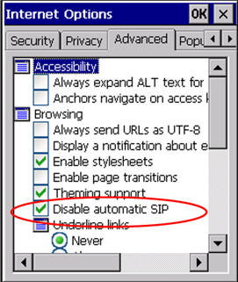
Example
When using Pick-IT ASP in Internet Explorer, the SIP (software input panel, or virtual keyboard) will pop up when a textbox is activated. We cannot control this panel through Pick-IT. The method disables this SIP, depending on your mobile device model and operating system.

Slide 18
2. Authentication Service Security
Two components of security in mobile computing:
Security of devices
Security in Networks
Involves mutual authentication between the device and the base station/ servers.
Ensures that only authenticated devices can be connected to the network
Hence, no malicious code can impersonate the service provider to trick the device.

Slide 19
Eminent kinds of attacks on mobile devices:
Push attacks
Pull attacks
Crash attack

Slide 20
3.Cryptographic Security for Mobile Devices:
Cryptographically Generated Address (CGA)
CGA is IPv6: generated by hashing owner’s public-key address
The address the owner uses is the corresponding private key to assert address ownership and
To sign messages sent from the address without a Public-Key Infrastructure(PKI)
CGA-based Authentication can be used to protect IP-Layer signaling protocols
Also used in key –exchange and create an IPSec security association for encryption and data authentication

Slide 21
Example: Palm OS5
Cryptographic Provider Manage(CPM) in Palm OS5 is a system-wide suite of cryptographic services for securing data and resources on a Palm- powered device

Slide 22
4. LDAP security for hand held mobile computing devices
LDAP is a software protocol for enabling anyone to locate individuals, organizations and other resources like files and devices on the network.
LDAP is light weight version of Directory Access Protocol(DAP) since it does not include security features in its initial version.
It originated at the University of Michigan.
Endorsed by atleast 40 companies.
Centralized directories such as LDAP make revoking permissions quick and easy.

Slide 23
LDAP directory Structure: simple tree structure
Root directory
Countries
Organizations
Organizational units
individuals

Slide 24
5. RAS security for mobile devices
RAS is important for protecting business sensitive data that ay reside on the employee’s mobile devices.
Vulnerable to unauthorized access : resulting in providing a route into the systems with which they connect
By impersonating or masquerading to these systems, a cracker is able to steal data or compromise corporate systems in other ways.
Another threat is by port scanning: DNS server- locate IP address- scan the port on this IP address that are unprotected.
Precautions: a personal firewall.

Slide 25
RAS system security for Mobile device clients
The security of the RAS server
The security of the RAS client
The secure data transmission

Slide 26
6. Media Player Control Security
Potential security attacks on mobile devices through the “music gateways”.
Windows media player: MS warned about security loop holes.
Corrupt files posing as normal music and video files.
May open a website from where the Javascript can be operated.
Allow attacker to download and use the code on user’s machine
Create buffer overrun errors.

Slide 27
7. Networking API security for mobile computing applications
Development of various API’s to enable software and hardware developers to write single applications to target multiple security platforms

Slide 28
Attacks on Mobile/ cell phones
Mobile Phone Theft
Mobile Viruses
Mishing
Vishing
Smishing
Hacking bluetooth

Slide 29
Mobile phone theft
With mobiles or cell phones becoming fancier, more popular, and more expensive, they are increasingly liable to theft.
The following factors contribute for outbreaks on mobile devices:
Enough target terminals: first mobile virus in 2004 :- Mosquito – this virus sent SMS text messages to the organization(Ojam).
2. Enough functionality: office functionality, critical data and applications protected insufficiently or not at all expanded functionality increases the probability of malware.
3. Enough connectivity: SMS, MMS, Synchronization, blue tooth, infrared(IR) and WLAN connections

Slide 30
How to Protect a Mobile Phone from Being Stolen
Keep details. Make a record of all your phone information and keep this in a safe place. Include the following elements in the information: Your phone number.
The make and model.
Color and appearance details.
The pin or security lock code.
The IMEI number (on GSM phones)
International Mobile Equipment Identity

Slide 31
Add a security mark.
Use an ultra violet pen to print your post code and house number onto both your mobile handset and battery. This makes it easily identifiable as your property if lost or stolen. It would also be good if you write your alternate contact number or email id on your phone.
This would help the finder of your handset to contact you if he or she intents to return it. The ultra-violet pen marking will wear off every couple of months, so reapply it when you feel necessary.
Use the security lock code, or PIN feature, to lock your phone. This will make it less valuable to a thief and deny them access to personal numbers stored on your SIM card.

Slide 32
Register your phone with your network operator. If your phone is stolen, report the loss to them immediately. Using your IMEI number, they may be able to block your hand set and account details.
Some wireless carriers are willing to do this, and some aren't. If done, this will prevent anyone from using the phone across any network, even if the SIM card is changed. Keep in mind that once the phone is disabled, it may not be able to be used again, even if you get it back.
Keep records of this call--the date, time, name of the person you spoke to, what they said, and their extension. Ask for confirmation in writing that your phone has been disabled.^{[2]} This is important in case the thief makes fraudulent charges on your account.

Slide 33
Have your phone number disabled.
In addition to reporting your phone lost or stolen, you should also disable your phone number (not account) so that no further charges can be applied. This is in case the thief figures out how to access your account through another hand set, or in case the carrier is unwilling to block the handset.
Remember that, as mentioned earlier, many thieves stand to benefit from using your service rather than selling your phone, especially between the moment they steal it and the moment you realize your phone is missing.^{[3]} As in the previous step, keep detailed records of when you requested your account to be disabled.

Slide 34
Request an immediate, formal investigation from your carrier.
Sometimes this can prevent (or at least delay) the carrier from launching a collections effort and tainting your credit, if things get ugly.
File a police report immediately.
Time is money, literally. A thief can add over US$10,000 to your cell phone bill in just hours by making international calls, and you might end up being asked to foot the bill. Some phone companies may require proof that the phone was actually stolen, versus it having been lost. A police report serves as evidence, which will make your wireless provider more cooperative, especially if insurance is involved.

Slide 35
Install anti phone theft software. There are suppliers that provide modern anti theft software for your phone. The software enables you to remotely contact your mobile and stay in control. For example, one of the recently published solutions for Symbian and Android is Theft Aware; others provide Windows Mobile or Blackberry support.
Never let the phone get out of your sight. Unless you are sleeping of course, always have your eyes on the phone.

Slide 36
2. Mobile Viruses
40 virus families
300+ mobile viruses identified
First mobile virus : june 2004
Spread through dominant communication protocols
Bluetooth, MMS

Slide 37
How to protect from mobile malware attacks
Download or accept progrms and content only from a trusted source.
Turn off bluetooth or set it to non-discoverable when not in use.
Receive IR beams only from trusted source.
Install antivirus software.

Slide 38
Mobile Phone Virus Hoax
Forwarded messages claim that a destructive virus will infect your mobile (cell) phone if you receive a call that displays "ACE" or "XALAN" on the screen.

Slide 39
Example
All mobile users pay attention!!!!!!!!! If you receive a phone call and your mobile phone displays(XALAN)on the screen don't answer the call, END THE CALL IMMEDIATELY, if you answer the call, your phone will be infected by a virus. This virus WILL ERASE all IMEI and IMSI information from both your phone and your SIM card, which will make your phone unable to connect with the telephone network. You will have to buy a new phone. This information has been confirmed by both Motorola and Nokia. There are over 3 Million mobile phones being infected by this virus in all around the world now. You can also check this news in the CNN web site. PLEASE FORWARD THIS PIECE OF INFORMATION TO ALL YOUR FRIENDS HAVING A MOBILE PHONE.

Slide 40
Variants of this hoax have been circulating since 1999. The information in the email is completely untrue and has certainly not been "confirmed by both Motorola and Nokia".

Slide 41
3. Mishing
'Mishing' is a combination of the words mobile phone and phishing.
Mishing is very similar to phishing—the only difference is the technology.
Phishing involves the use of emails to trick you into providing your personal details, whereas mishing involves mobile phones.
If you use your mobile phone for purchasing goods and services and convenient banking, you could be more vulnerable to a mishing scam.

Slide 42
Variants of Mishing
Vishing : Mishing attacker makes call for phishing
Smishing: Mishing attacker sends SMS for phishing

Slide 43
Vishing
The term "vishing" is a socially engineered technique for stealing information or money from consumers using the telephone network.
The term comes from combining "voice" with "phishing," which are online scams that get people to give up personal information.
Vishing is very similar to phishing—the only difference is the technology.
Vishing involves voice or telephone services. If you use a Voice over Internet Protocol (VoIP) phone service, you are particularly vulnerable to a vishing scam.
Vishing is usually used to steal credit card numbers or other related data used in ID theft schemes from individuals.

Slide 44
Profitable uses of the information gained through a Vishing attack include:
ID theft.
Purchasing luxury goods and services.
Transferring money/ funds.
Monitoring the victims bank accounts.
Making applications for loans and credit cards.

Slide 45
How Vishing works?
a vishing perpetrator (visher) may gain access to a group of private customer phone numbers.
The visher may then call the group(may use war dialer).
When a potential victim answers the phone, he or she hears an automated recording informing him that his bank account has been compromised.
He then calls the specified toll-free number to reset his security settings and hears another automated message requesting the user’s bank account number and/or other personal details via the phone keypad.

Slide 46
How to protect from Vishing attack?
Be suspicious of all unknown callers.
Don't trust caller ID: caller ID spoofing is easy.
Ask questions: ask them to identify who they work for, and then check them out to see if they are legitimate.
Call them back: call them back using a number from your bill or your card. Never provide credit card information or other private information to anyone who calls you.
Report incidents: to nearest cyberpolice cell.

Slide 47
Smishing
Short for SMS Phishing, smishing is a variant of phishing email scams that instead utilizes Short Message Service (SMS) systems to send bogus text messages.
Also written as SMiShing, SMS phishing made recent headlines when a vulnerability in the iPhone's SMS text messaging system was discovered that made smishing on the mobile device possible.

Slide 48
How smishing works?
Smishing scams frequently seek to direct the text message recipient to visit a website or call a phone number, at which point the person being scammed is enticed to provide sensitive information such as credit card details or passwords.
Smishing websites are also known to attempt to infect the person's computer with malware.

Slide 49
Example
Text message originating from either notice@jpecu or message@cccu :
ABC CU – has –deactivated – your Debit_card. To reactivate contact:210957XXXX
This is an automated message from ABC Bank.
Your ATM card has been suspended. To reactivate call urgent at 1 866 215 XXXX
Text message originating from sms.alert@visa.com :
sms.alert@visa.com/VISA. (Card Blocked) Alert. For more information please call 1-877-269-XXXX

Slide 50
How to protect from Smishing attacks?
Do not answer a text message
Avoid calling any phone numbers
Never click on a hot link received through messages

Slide 51

Hacking bluetooth
Bluetooth hacking is a technique used to get information from another Bluetooth enabled device without any permissions from the host.
This event takes place due to security flaws in the Bluetooth technology.
It is also known as Bluesnarfing.
Bluetooth hacking is not limited to cell phones, but is also used to hack PDAs, Laptops and desktop computers.
Bluetooth hacking is illegal and can lead to serious consequences.

Slide 52
Following are threats a person can face when his/her mobile phone gets bluesnarfed:
The hacker can steal, delete contacts.
Hacker can extract personal files/pictures etc.
Your cell phone can be used for making calls and using internet at your expense.
The hacker may call or text your contacts to annoy them.
You mobile phone can be reset to default factory settings hence deleting your personal settings.
Hacker can even access your calendar, clock, International Mobile Equipment Identity (IMEI) number. IMEI number can be used to clone your cell phone so that your messages are also routed to another number. Cloning is also considered illegal.

Slide 53
Common attacks
Bluejacking:
Bluesnarfing
Bluebugging
Car wishper

Slide 54
Bluejacking
Bluejacking is the sending of unsolicited messages over Bluetooth to Bluetooth-enabled devices such as mobile phones, PDAs or laptop computers, sending a vCard which typically contains a message in the name field (i.e., for bluedating or bluechat) to another Bluetooth-enabled device .
Bluejacking is also known as bluehacking.
Bluejacking exploits a basic Bluetooth feature that allows devices to send messages to contacts within range.
Bluejacking is harmless.

Slide 55
Bluesnarfing
Bluesnarfing is the unauthorized access of information from a wireless device through a Bluetooth connection, often between phones, desktops, laptops, and PDAs (personal digital assistant).
This allows access to a calendar, contact list, emails and text messages, and on some phones, users can copy pictures and private videos.
Both Bluesnarfing and Bluejacking exploit others' Bluetooth connections without their knowledge.
While Bluejacking is essentially harmless as it only transmits data to the target device, Bluesnarfing is the theft of information from the target device.

Slide 56
Bluebugging
Bluebugging is a form of Bluetooth attack often caused by a lack of awareness.
It was developed after the onset of bluejacking and bluesnarfing. Similar to bluesnarfing, bluebugging accesses and uses all phone features.
Bluebugging manipulates a target phone into compromising its security, this to create a backdoor attack before returning control of the phone to its owner. Once control of a phone has been established, it is used to call back the hacker who is then able to listen-in to conversations.
The Bluebug program also has the capability to create a call forwarding application whereby the hacker receives calls intended for the target phone.
Not only can a hacker receive calls intended for the target phone, he can send messages, read phonebooks, and examine calendars.

Slide 57
Common bluetooth attack tools
BTScanner
Bluesnarfer
Bluediving
Blue bugger
bluesniff

Slide 58
Mobile Devices: Security Implications for Organizations
Managing diversity and proliferation of Hand-Held devices.
Unconventional/ stealth storage devices.
Threat through lost and stolen devices.
Protecting data on lost devices.
Educating the laptop users.

Slide 59
1. Managing diversity and proliferation of Hand-Held devices
Employees aren't just bringing their mobile devices to the workplace—they're living on them.
As smartphones and tablets become constant companions, cyber attackers are using every avenue available to break into them.
With the right (inexpensive) equipment, hackers can gain access to a nearby mobile device in less than 30 seconds and either mirror the device and see everything on it, or install malware that will enable them to siphon data from it at their leisure.

Slide 60
Managing diversity and proliferation of Hand-Held devices
Analysts predict that by 2018, 25 percent of corporate data will completely bypass perimeter security and flow directly from mobile devices to the cloud.
Chief information security officers (CISOs) and other security executives are finding that the proliferation of mobile devices and cloud services are their biggest barriers to effective breach response.
In order to secure the corporate data passing through or residing on mobile devices, it is imperative to fully understand the issues they present.

Slide 61
5 Security Risks and a Surprising Challenge
Physical access
Malicious Code
Device Attacks
Communication Interception
Insider Threats

Slide 62
Physical access
Mobile devices are small, easily portable and extremely lightweight.
hence easy to steal or leave behind in airports, airplanes or taxicabs.
As with more traditional devices, physical access to a mobile device equals “game over.”
The cleverest intrusion-detection system and best anti-virus software are useless against a malicious person with physical access.
Circumventing a password or lock is a trivial task for a seasoned attacker, and even encrypted data can be accessed.
This may include not only corporate data found in the device, but also passwords residing in places like the iPhone Keychain, which could grant access to corporate services such as email and virtual private network (VPN).

Slide 63
Malicious Code
Mobile malware threats are typically socially engineered and focus on tricking the user into accepting what the hacker is selling.
The most prolific include spam, weaponized links on social networking sites and rogue applications.
Android devices are the biggest targets, as they are widely used and easy to develop software for.
Mobile malware Trojans designed to steal data can operate over either the mobile phone network or any connected Wi-Fi network.
They are often sent via SMS (text message); once the user clicks on a link in the message, the Trojan is delivered by way of an application, where it is then free to spread to other devices.
When these applications transmit their information over mobile phone networks, they present a large information gap that is difficult to overcome in a corporate environment.

Slide 64
Device Attacks
Attacks targeted at the device itself are similar to the PC attacks of the past.
Browser-based attacks, buffer overflow exploitations and other attacks are possible.
The short message service (SMS) and multimedia message service (MMS) offered on mobile devices afford additional avenues to hackers.
Device attacks are typically designed to either gain control of the device and access data, or to attempt a distributed denial of service (DDoS).

Slide 65
Communication Interception
Wi-Fi-enabled smartphones are susceptible to the same attacks that affect other Wi-Fi-capable devices.
The technology to hack into wireless networks is readily available, and much of it is accessible online, making Wi-Fi hacking and man-in-the-middle (MITM) attacks easy to perform.
Cellular data transmission can also be intercepted and decrypted.
Hackers can exploit weaknesses in these Wi-Fi and cellular data protocols to eavesdrop on data transmission, or to hijack users’ sessions for online services, including web-based email.
For companies with workers who use free Wi-Fi hot spot services, the stakes are high.
While losing a personal social networking login may be inconvenient, people logging on to enterprise systems may be giving hackers access to an entire corporate database.

Slide 66
Insider Threats
Mobile devices can also facilitate threats from employees and other insiders.
Malicious insiders can use a smartphone to misuse or misappropriate data by downloading large amounts of corporate information to the device’s secure digital (SD) flash memory card, or by using the device to transmit data via email services to external accounts.
The downloading of applications can also lead to unintentional threats.
The misuse of personal cloud services through mobile applications is another issue; when used to convey enterprise data, these applications can lead to data leaks that the organization remains entirely unaware of.
Many device users remain unaware of threats, and the devices themselves tend to lack basic tools that are readily available for other platforms, such as anti-virus, anti-spam, and endpoint firewalls.

Slide 67
Policy making efforts
Organization needs to establish security practice subject to legal and external constraints.
Policy making effort starts with the commitment of CEO, president or Director who takes cybersecurity seriously.
Mobile devices of the employees should be registered in the corporate asset register.
Close monitoring of these devices.
Physical access to corporate resources must be removed from mobile devices before the employee leaves.
Employees register their device with the IT department: to control the access.

Slide 68
Unconventional/ Stealth Storage devices
Secondary storage devices
CDs
USBs
Portable external hard disks
Portable storage devices can be easily lost or stolen.
Decrease in size and emerge in new shape and sizes – difficult to detect.
Prime challenge for organizational security.
Firewalls and antivirus software are no defense against the open USB ports.
Remedy- block these ports, but Windows OS do not support
Disgruntled employee can use these to download confidential data or upload harmful virus.

Slide 69
Device lock software
Device Lock provides network administrators the ability to set and enforce contextual policies for how, when, where to, and by whom data can or can’t be moved to or from company laptops or desktop PCs via devices like phones, digital cameras, USB sticks, CD/DVD-R, tablets, printers or MP3 players.
In addition, policies can be set and enforced for copy operations via the Windows Clipboard, as well as screenshot operations on the endpoint computer.

Slide 70
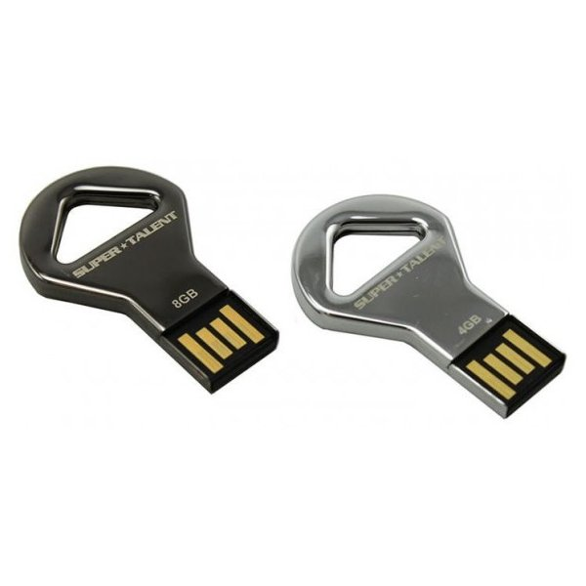


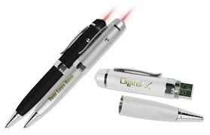
Stealth storage devices

Slide 71
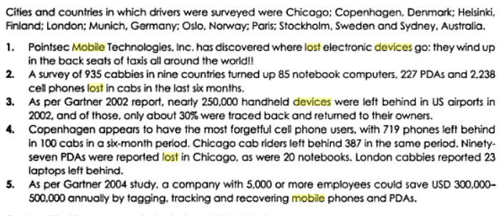
3. Threats through lost and stolen devices

Slide 72
4. Protecting data on lost devices
Encrypting sensitive data
Encrypting entire file system
Encrypting servers: third party solutions
Create a database action to delete the entire data on the user’s device

Slide 73
5. Educating the Laptop users
No free downloads
Illegal music files and movies
86% employees do this

Slide 74
Tools and Methods used in Cybercrime
UNIT-2
PART-2

Slide 75
Unit 4: Learning Objectives
Proxy servers and anonymizers
Password cracking
Keyloggers and spywares
Overview of virus and worms
Trojan horses and backdoors
Steganography
DoS and DDoS attacks
SQL injection
Buffer overflow

Slide 76
Stages of an attack on network
Initial covering: two stages
Reconnaissance- social networking websites
Uncovers information on company’s IP
Network probe:
Ping sweep- seek out potential targets
Port scanning
Crossing the line toward electronic crime:
Commits computer crime by exploiting possible holes on the target system

Slide 77
Stages of an attack on network
4. Capturing the network:
- attackers attempts to own the network
- uses tools to remove any evidence of the attack
- trojan horses, backdoors
5. Grab the data:
- attacker has captured the network
- steal confidential data, customer CC information, deface webpages…
6. Covering the attack:
- extend misuse of the attack without being detected.
- start a fresh reconnaissance to a related target system
- continue use of resources
- remove evidence of hacking

Slide 78
Various tools used for the attack
Proxy severs and Anonymizers
Phishing
Password cracking
Keyloggers and spywares
Virus and Worms
Trojan horses and Backdoors
Steganography
SQL injection
DoS and DDoS attack tools
Buffer overflow

Slide 79
1. Proxy severs and Anonymizers
A proxy server is a dedicated computer or a software system running on a computer that acts as an intermediary between an endpoint device, such as a computer, and another server from which a user or client is requesting a service.
A client connects to the proxy server, requesting some service, such as a file, connection, web page, or other resource available from a different server and the proxy server evaluates the request as a way to simplify and control its complexity.

Slide 80
Purpose of a proxy server
Improve Performance:
Filter Requests
Keep system behind the curtain
Used as IP address multiplexer
Its Cache memory can serve all users
Attack on this: the attacker first connects to a proxy server- establishes connection with the target through existing connection with the proxy.

Slide 81
An Anonymizer
An anonymizer or an anonymous proxy is a tool that attempts to make activity on the Internet untraceable.
It is a proxy server computer that acts as an intermediary and privacy shield between a client computer and the rest of the Internet.
It accesses the Internet on the user's behalf, protecting personal information by hiding the client computer's identifying information.
For example, large news outlets such as CNN target the viewers according to region and give different information to different populations

Slide 82
2. Phishing
Stealing personal and financial data
Also can infect systems with viruses
A method of online ID theft

Slide 83
How Phishing works?
Planning : use mass mailing and address collection techniques- spammers
Setup : E-Mail / webpage to collect data about the target
Attack : send a phony message to the target
Collection: record the information obtained
Identity theft and fraud: use information to commit fraud or illegal purchases

Slide 84
3. Password Cracking
password cracking is the process of recovering passwords from data that have been stored in or transmitted by a computer system.
A common approach (brute-force attack) is to try guesses repeatedly for the password and check them against an available cryptographic hash of the password.

Slide 85
The purpose of password cracking
help a user recover a forgotten password
to gain unauthorized access to a system,
or as a preventive measure by System Administrators to check for easily crackable passwords

Slide 86
Manual Password Cracking Algorithm
Find a valid user •Create a list of possible passwords •Rank the passwords from high probability to low •Key in each password •If the system allows you in - Success •Else try till success

Slide 87
examples of guessable passwords
Blank
Words like “passcode” ,”password”, “admin”
Series of letters “QWERTY”
User’ s name or login name
Name of the user’s friend/relative/pet
User’s birth place, DOB
Vehicle number, office number ..
Name of celebrity
Simple modification of one of the precedings, suffixing 1 …

Slide 88
Categories of password cracking attacks:
Online attacks
Offline attacks
Non-electronic attacks
Social engineering
Shoulder surfing
Dumpster diving

Slide 89
Online attacks
An attacker may create a script- automated program- to try each password
Most popular online attack;- man-in-the-middle attack or bucket-brigade attack
Used to obtain passwords for E-mail accounts on public websites like gmail, yahoomail
Also to get passwords for financial websites

Slide 90
Offline attacks
Are performed from a location other than the target where these passwords reside or are used
Require physical access to the computer and copying the password

Slide 91
Types of Password Attacks
Password Guessing
Attackers can guess passwords locally or remotely using either a manual or automated approach
Dictionary attacks
work on the assumption that most passwords consist of whole words, dates, or numbers taken from a dictionary.
Hybrid password
assume that network administrators push users to make their passwords at least slightly different from a word that appears in a dictionary.

Slide 92
Weak passwords
The password contains less than eight characters
The password is a word found in a dictionary (English or foreign)
The password is a common usage word such as:
Names of family, pets, friends, co-workers, fantasy characters, etc.
Computer terms and names, commands, sites, companies, hardware, software.
The words "<Company Name>", "sanjose", "sanfran" or any derivation.
Birthdays and other personal information such as addresses and phone numbers.
Word or number patterns like aaabbb, qwerty, zyxwvuts, 123321, etc.
Any of the above spelled backwards.
Any of the above preceded or followed by a digit (e.g., secret1,1secret

Slide 93
Strong Passwords
Contain both upper and lower case characters (e.g., a-z, A-Z)
Have digits and punctuation characters as well as letters e.g., 0-9, @#$%^&*()_+|~-=\`{}[]:";'<>?,./)
Are at least eight alphanumeric characters long.
Are not a word in any language, slang, dialect, jargon, etc.
Are not based on personal information, names of family, etc.
Passwords should never be written down or stored on-line.
Try to create passwords that can be easily remembered.
One way to do this is create a password based on a song title, affirmation, or other phrase.
For example, the phrase might be: "This May Be One Way To Remember"
and the password could be: "TmB1w2R!" or "Tmb1W>r~" or some other variation.

Slide 94
Random passwords
Secure Password Generator
Password Length:
Include Symbols:
( e.g. @#$% )
Include Numbers:
( e.g. 123456 )
Include Lowercase Characters:
( e.g. abcdefgh )
Include Uppercase Characters:
( e.g. ABCDEFGH )
Exclude Similar Characters:
( e.g. i, l, 1, L, o, 0, O )
Exclude Ambiguous Characters:
( { } [ ] ( ) / \ ' " ` ~ , ; : . < > )
Generate On The Client Side:
( do NOT send across the Internet )
Auto-Select:
( select the password automatically )
Save My Preference:
( save all the settings above for later use )
Load My Settings Anywhere:
URL to load my settings on other computers quickly
Your New Password:
Remember your password:
Remember your password with the first letters of each word in this sentence.
To prevent your passwords from being hacked by social engineering, brute force or dictionary attack method, you should notice that:
1. Do not use the same password for multiple important accounts.
2. Use a password that has at least 16 characters, use at least one number, one uppercase letter, one lowercase letter and one special symbol.
3. Do not use the names of your families, friends or pets in your passwords.
4. Do not use postcodes, house numbers, phone numbers, birthdates, ID card numbers, social security numbers, and so on in your passwords.
5. Do not use any dictionary word in your passwords.
6. Do not use something that can be cloned( but you can't change ) as your passwords, such as your fingerprints.
7. Do not let your Web browsers( FireFox, Chrome, Safari, Opera, IE ) store your passwords, since all passwords saved in Web browsers can be revealed easily.
8. Do not log in to important accounts on the computers of others, or when connected to a public Wi-Fi hotspot, Tor, free VPN or web proxy.
9. Do not send sensitive information online via HTTP or FTP connections, because messages in these connections can be sniffed with very little effort. You should use encrypted connections such as HTTPS and SFTP whenever possible.
10. When travelling, you can encrypt your Internet connections before they leave your laptop, tablet, mobile phone or router. For example, you can set up a private VPN on your own server( home computer, dedicated server or VPS ) and connect to it. Alternatively, you can set up an encrypted SSH tunnel between your router and your home computer( or a remote server of your own ) with PuTTY and connect your programs( e.g. FireFox ) to PuTTY. Then even if somebody captures your data as it is transmitted between your device( e.g. laptop, iPhone, iPad ) and your server with a packet sniffer, he'll won't be able to steal your data and passwords from the encrypted streaming data.
11. How secure is my password? Perhaps you believe that your passwords are very strong, difficult to hack. But if a hacker has stolen your username and the MD5 hash value of your password from a company's server, and the rainbow table of the hacker contains this MD5 hash, then your password will be cracked quickly.
To check the strength of your passwords and know whether they're inside the popular rainbow tables, you can convert your passwords to MD5 hashes on this MD5 hash generator, then decrypt your passwords by submitting these hashes to an online MD5 decryption service. For instance, your password is "0123456789A", using the brute-force method, it may take a computer almost one year to crack your password, but if you decrypt it by submitting its MD5 hash( C8E7279CD035B23BB9C0F1F954DFF5B3 ) to a MD5 decryption website, how long will it take to crack it? You can perform the test yourself.
12. It's recommended to change your passwords every 10 weeks.
13. It's recommended that you remember a few master passwords, store other passwords in a plain text file and encrypt this file with 7-Zip, GPG or a disk encryption software such as BitLocker, or manage your passwords with a password management software.
14. Encrypt and backup your passwords to different locations, then if you lost access to your computer or account, you can retrieve your passwords back quickly.
15. Turn on 2-step authentication whenever possible.
16. Do not store your critical passwords in the cloud.
17. Access important websites( e.g. Paypal ) from bookmarks directly, otherwise please check its domain name carefully, it's a good idea to check the popularity of a website with Alexa toolbar to ensure that it's not a phishing site before entering your password.
18. Protect your computer with firewall and antivirus software, download software from reputable sites only, and verify the MD5 or SHA1 checksum of the installation package whenever possible.
19. Be careful when using online paste tools and screen capture tools, do not let them to upload your passwords to the cloud.
20. If there are important files on your computer, and it can be accessed by others, check if there are hardware keyloggers( e.g. wireless keyboard sniffer ), software keyloggers and hidden cameras when you feel it's necessary.
21. If you're a webmaster, do not store the users passwords in the database, you should store the salted hash values of passwords inste

Slide 95
4. keyloggers
Keystroke logging, often referred to as keylogging or keyboard capturing, is the action of recording (or logging) the keys struck on a keyboard, typically in a covert manner so that the person using the keyboard is unaware that their actions are being monitored.
It has uses in the study of human–computer interaction.
There are numerous keylogging methods, ranging from hardware and software-based approaches to acoustic analysis.

Slide 96
Software-based keyloggers
Software-based keyloggers use the target computer’s operating system in various ways, including: imitating a virtual machine, acting as the keyboard driver (kernel-based), using the application programming interface to watch keyboard strokes (API-based), recording information submitted on web-based forms (Form Grabber based) or capturing network traffic associated with HTTP POST events to steal passwords (Packet analyzers).
Usually consists of two files DLL and EXE

Slide 97
Hardware keyloggers
installing a hardware circuit between the keyboard and the computer that logs keyboard stroke activity (keyboard hardware).
Target- ATMs

Slide 98
Acoustic keylogging
Acoustic keylogging monitors the sound created by each individual keystroke and uses the subtly different acoustic signature that each key emits to analyze and determine what the target computer’s user is typing.

Slide 99
AntiKeylogger
An anti-keylogger (or anti–keystroke logger) is a type of software specifically designed for the detection of keystroke logger software; often, such software will also incorporate the ability to delete or at least immobilize hidden keystroke logger software on your computer.

Slide 100
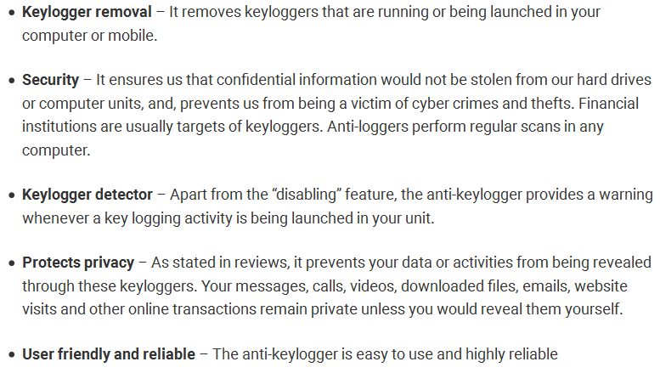
Benefits of Antikeyloggers

Slide 101
Spywares
Spyware is software that aims to gather information about a person or organization without their knowledge and that may send such information to another entity without the consumer's consent, or that asserts control over a computer without the consumer's knowledge

Slide 102
5. Virus and Worms
A computer virus is a malware program that, when executed, replicates by inserting copies of itself (possibly modified) into other computer programs, data files, or the boot sector of the hard drive; when this replication succeeds, the affected areas are then said to be "infected".

Slide 103
Some typical virus actions
Display a message to prompt an action
Delete files in the system
Scramble data on a hard disk
Cause erratic screen behavior
Halt the system
Replicate themselves to propagate further harm

Slide 104
Virus spread through
The internet
A stand alone PC
Local networks

Slide 105
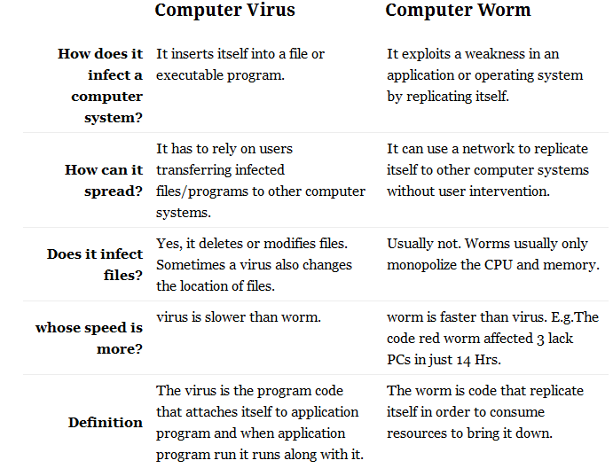
Difference between virus and worm

Slide 106
Types of viruses
Boot sector viruses
Program viruses
Multipartite viruses
Stealth viruses
Polymorphic viruses
Macroviruses
Active X and Java contrl

Slide 107
Boot sector viruses
A boot sector virus is a computer virus that infects a storage device's master boot record (MBR).
It is not mandatory that a boot sector virus successfully boot the victim's PC to infect it.
As a result, even non-bootable media can trigger the spread of boot sector viruses.
These viruses copy their infected code either to the floppy disk's boot sector or to the hard disk's partition table. During start-up, the virus gets loaded to the computer's memory. As soon as the virus is saved to the memory, it infects the non-infected disks used by the system.
The propagation of boot sector viruses has become very rare since the decline of floppy disks. Also, present-day operating systems include boot-sector safeguards that make it difficult for boot sector viruses to infect them.

Slide 108
Program viruses
A program virus becomes active when the program file (usually with extensions .BIN, .COM, .EXE, .OVL, .DRV) carrying the virus is opened.
Once active, the virus will make copies of itself and will infect other programs on the computer.

Slide 109
Multipartite viruses
A multipartite virus is a fast-moving virus that uses file infectors or boot infectors to attack the boot sector and executable files simultaneously.
Most viruses either affect the boot sector, the system or the program files.
The multipartite virus can affect both the boot sector and the program files at the same time, thus causing more damage than any other kind of virus.
When the boot sector is infected, simply turning on the computer will trigger a boot sector virus because it latches on to the hard drive that contains the data that is needed to start the computer. Once the virus has been triggered, destructive payloads are launched throughout the program files.
A multipartite virus infects computer systems multiple times and at different times. In order for it to be eradicated, the entire virus must be removed from the system.
A multipartite virus is also known as a hybrid virus.

Slide 110
Stealth viruses
A stealth virus is a hidden computer virus that attacks operating system processes and averts typical anti-virus or anti-malware scans. Stealth viruses hide in files, partitions and boot sectors and are adept at deliberately avoiding detection. Stealth virus eradication requires advanced anti-virus software or a clean system reboot.

Slide 111
Polymorphic viruses
A polymorphic virus is a complicated computer virus that affects data types and functions.
It is a self-encrypted virus designed to avoid detection by a scanner.
Upon infection, the polymorphic virus duplicates itself by creating usable, albeit slightly modified, copies of itself.
Polymorphism, in computing terms, means that a single definition can be used with varying amounts of data. In order for scanners to detect this type of virus, brute-force programs must be written to combat and detect the polymorphic virus with novel variant configurations.

Slide 112
Macroviruses
A macro virus is a computer virus that "infects" a Microsoft Word or similar application and causes a sequence of actions to be performed automatically when the application is started or something else triggers it.

Slide 113
Active X and Java contrl
ActiveX and Java were created for web page designers to incorporate a wide array of impressive effects on web pages, giving movement and added dimension to the previously "flat" web pages.
To operate properly, these ActiveX controls and Java applets need to gain access to your hard disk. Insufficient memory and bandwidth problems necessitate this approach. Although this desktop access provides a wealth of beneficial applications of these controls and applets, malicious code developers have the same access. They are now using it to read and delete or corrupt files, access RAM, and even access files on computers attached via a LAN.

Slide 114

6. Trojan horses and Backdoors
A Trojan horse, or Trojan, in computing is generally a non-self-replicating type of malware program containing malicious code that, when executed, carries out actions determined by the nature of the Trojan, typically causing loss or theft of data, and possible system harm

Slide 115
Examples of threats by trojans
Erase, overwrite or corrupt data on a computer
Help to spread other malware such as viruses- dropper trojan
Deactivate or interface with antivirus and firewall programs
Allow remote access to your computer- remote access trojan
Upload and download files
Gather E-mail address and use for spam
Log keystrokes to steal information – pwds, CC numbers
Copy fake links to false websites
slowdown, restart or shutdown the system
Disable task manager
Disable the control panel

Slide 116

Backdoors
A backdoor in a computer system is a method of bypassing normal authentication, securing unauthorized remote access to a computer, obtaining access to plaintext, and so on, while attempting to remain undetected.
Also called a trapdoor. An undocumented way of gaining access to a program, online service or an entire computer system.
The backdoor is written by the programmer who creates the code for the program. It is often only known by the programmer. A backdoor is a potential security risk.

Slide 117
Functions of backdoors
Allows an attacker to
create, delete, rename, copy or edit any file
Execute commands to change system settings
Alter the windows registry
Run, control and terminate applications
Install arbitrary software and parasites
Control computer hardware devices,
Shutdown or restart computer

Slide 118
Functions of backdoors
Steals sensitive personal information, valuable documents, passwords, login name…
Records keystrokes, captures screenshots
Sends gathered data to predefined E-mail addresses
Infects files, corrupts installed apps, damages entire system
Distributes infected files to remote computers
Installs hidden FTP server
Degrades internet connection and overall system performance
Decreases system security
Provides no uninstall feature, hides processes, files and other objects

Slide 119
Examples of Backdoor trojans
Back Orifice : for remote system administration
Bifrost : can infect Win95 through Vista, execute arbitrary code
SAP backdoors : infects SAP business objects
Onapsis Bizploit: Onapsis Bizploit is an SAP penetration testing framework to assist security professionals in the discovery, exploration, vulnerability assessment and exploitation phases of specialized SAP security assessment

Slide 120
How to protect from Trojan Horses and backdoors
Stay away from suspect websites/ links
Surf on the web cautiously : avoid P2P networks
Install antivirus/ Trojan remover software

Slide 121
7. Steganography
Steganography (from Greek steganos, or "covered," and graphie, or "writing") is the hiding of a secret message within an ordinary message and the extraction of it at its destination.
Steganography takes cryptography a step farther by hiding an encrypted message so that no one suspects it exists. Ideally, anyone scanning your data will fail to know it contains encrypted data.
Other names: data hiding, information hiding, digital watermarking

Slide 122
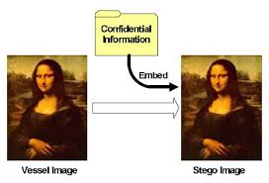
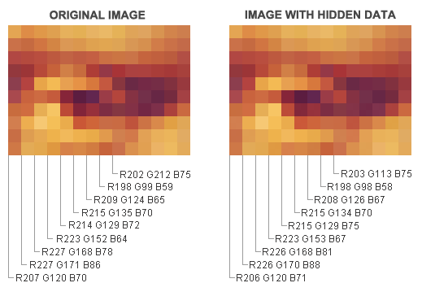

Slide 123
digital watermarking
Digital watermarking is the act of hiding a message (trademark) related to a digital signal (i.e. an image, song, video) within the signal itself.
It is a concept closely related to steganography, in that they both hide a message inside a digital signal.
However, what separates them is their goal.
Watermarking tries to hide a message related to the actual content of the digital signal,
while in steganography the digital signal has no relation to the message, and it is merely used as a cover to hide its existence.

Slide 124
Difference between steganography and cryptography
Cryptography is the study of hiding information, while Steganography deals with composing hidden messages so that only the sender and the receiver know that the message even exists.
In Steganography, only the sender and the receiver know the existence of the message, whereas in cryptography the existence of the encrypted message is visible to the world.
Due to this, Steganography removes the unwanted attention coming to the hidden message.
Cryptographic methods try to protect the content of a message, while Steganography uses methods that would hide both the message as well as the content.
By combining Steganography and Cryptography one can achieve better security.

Slide 125
Steganalysis
Steganalysis is the study of detecting messages hidden using steganography;
The goal of steganalysis is to identify suspected packages, determine whether or not they have a payload encoded into them, and, if possible, recover that payload.

Slide 126
8.DoS and DDoS attacks
In computing, a denial-of-service (DoS) or distributed denial-of-service (DDoS) attack is an attempt to make a machine or network resource unavailable to its intended users.
A DoS attack generally consists of efforts to temporarily or indefinitely interrupt or suspend services of a host connected to the Internet.

Slide 127
Symptoms of DoS attacks
Slow network performance
Unavailability of a particular website
Inability to access any website
Dramatic increase in number of Spam E-mails received

Slide 128
A DoS attack may do the following
Flood the traffic, thereby preventing network traffic
Disrupt connections between two systems- preventing access to service
Prevent a particular individual from accessing a service
Disrupt service to a specific system or person

Slide 130
Classification of DoS
Bandwidth attacks
Logic attacks
Protocol attacks
Unintentional DoS attack

Slide 131
Bandwidth attacks
The most common DoS attacks
target the computer's network bandwidth or connectivity.
Bandwidth attacks flood the network with such a high volume of traffic, that all available network resources are consumed and legitimate user requests can not get through.

Slide 132
Logic attacks
An attacker sends more requests to a server than it can handle, usually in a relentless manner, until the server buckles and gives in to the attacker. Once this type of attack ends, the server can return to normal operation.
Generally, a logic attack requires your server to have a discoverable weakness that the attacker can locate and then use against it.
Because of this prerequisite, it is usually easy to prevent by keeping your server software and hardware up-to-date with the latest security patches and firmware respectively

Slide 133
Protocol attacks
Denial of service attacks may take advantage of certain standard protocol features.
Several attacks capitalize on the fact that IP source addresses can be spoofed.
In addition, connection depletion attacks take advantage of the fact that many connection-oriented protocols require servers to maintain state information after a connection request is made but before the connection is fully established.
The most common connection depletion attack is SYN flooding

Slide 134
Unintentional DoS attack
This describes a situation where a website ends up denied, not due to a deliberate attack by a single individual or group of individuals, but simply due to a sudden enormous spike in popularity.
This can happen when an extremely popular website posts a prominent link to a second, less well-prepared site, for example, as part of a news story.

Slide 135
Types or levels of DoS attacks
Flood attack
Ping of death attack
SYN attack
Teardrop attack
Smurf attack
nuke

Slide 136
Flood attack
Flooding is a Denial of Service (DoS) attack that is designed to bring a network or service down by flooding it with large amounts of traffic.
Flood attacks occur when a network or service becomes so weighed down with packets initiating incomplete connection requests that it can no longer process genuine connection requests.
By flooding a server or host with connections that cannot be completed, the flood attack eventually fills the hosts memory buffer. Once this buffer is full no further connections can be made, and the result is a Denial of Service.

Slide 137
ping of death attack
ping of death is a denial of service (DoS) attack caused by an attacker deliberately sending an IP packet larger than the 65,536 bytes allowed by the IP protocol.

Slide 138
SYN attack
A SYN flood occurs when a host sends a flood of TCP/SYN packets, often with a forged sender address.
Each of these packets are handled like a connection request, causing the server to spawn a half-open connection, by sending back a TCP/SYN-ACK packet (Acknowledge), and waiting for a packet in response from the sender address (response to the ACK Packet).
However, because the sender address is forged, the response never comes. These half-open connections saturate the number of available connections the server can make, keeping it from responding to legitimate requests until after the attack ends

Slide 139
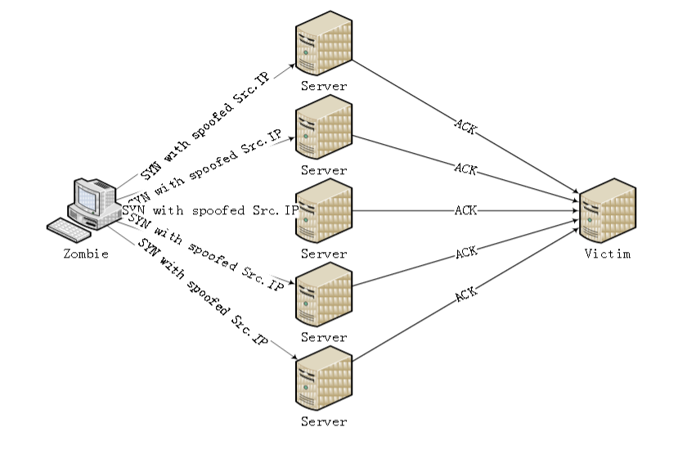
SYN attack

Slide 140
Teardrop attack
A teardrop attack is a denial of service (DoS) attack conducted by targeting TCP/IP fragmentation reassembly codes.
This attack causes fragmented packets to overlap one another on the host receipt;
the host attempts to reconstruct them during the process but fails.
Gigantic payloads are sent to the machine that is being targeted, causing system crashes.

Slide 141
Smurf attack
A smurf attack is a type of denial of service attack in which a system is flooded with spoofed ping messages.
This creates high computer network traffic on the victim’s network, which often renders it unresponsive.

Slide 142
Nuke
A Nuke is an old denial-of-service attack against computer networks consisting of fragmented or otherwise invalid ICMP packets sent to the target, achieved by using a modified ping utility to repeatedly send this corrupt data, thus slowing down the affected computer until it comes to a complete stop.

Slide 143
DDoS attack
A Distributed Denial of Service (DDoS) attack is an attempt to make an online service unavailable by overwhelming it with traffic from multiple sources.
They target a wide variety of important resources, from banks to news websites, and present a major challenge to making sure people can publish and access important information.

Slide 144
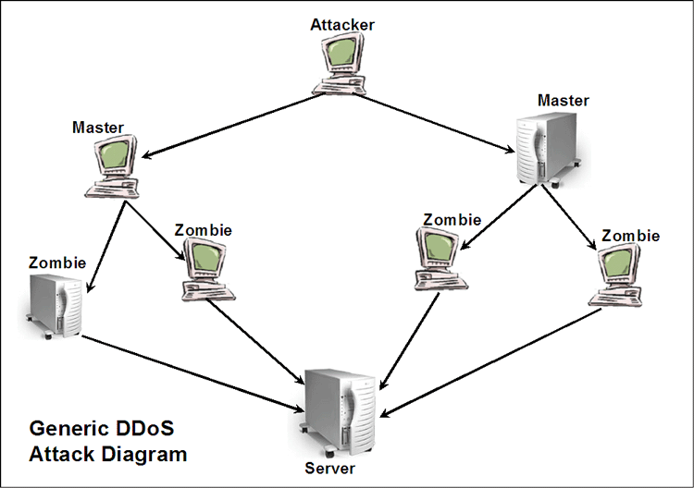

Slide 145
how to prevent dos/ddos attacks
Filtering: Routers at the edge of the network can be trained to spot and drop DDOS connections, preventing them from slowing the network or the server.
Moving: If the attack is pointed at a specific IP address, the site’s IP can be changed.
Blackholing: A host may simply “blackhole” a site that is being DDOSed, directing all traffic to it to an address that doesn’t exist. This is normally a last resort.

Slide 146

9. SQL Injection
SQL injection is a code injection technique, used to attack data-driven applications, in which malicious SQL statements are inserted into an entry field for execution (e.g. to dump the database contents to the attacker).
It is the type of attack that takes advantage of improper coding of your web applications that allows hacker to inject SQL commands into say a login form to allow them to gain access to the data held within your database.

Slide 147
What an attacker can do?
* ByPassing Logins : by obtaining username and passwords
* Accessing secret data : reconnaissance
* Adding new data or Modifying contents of website: INSERT/UPDATE
* Shutting down the My SQL server

Slide 148
steps for SQL Injection attack
Step 1: Finding Vulnerable Website:
find the Vulnerable websites(hackable websites) using Google Dork list.
google dork is searching for vulnerable websites using the google searching tricks
use “inurl:” command for finding the vulnerable websites.
Some Examples: inurl:index.php?id= inurl:gallery.php?id= inurl:article.php?id= inurl:pageid=
How to use? copy one of the above command and paste in the google search engine box. Hit enter. You can get list of web sites. We have to visit the websites one by one for checking the vulnerability.

Slide 149
Step 2: Checking the Vulnerability:
Now we should check the vulnerability of websites.
In order to check the vulnerability ,add the single quotes(‘) at the end of the url and hit enter.
For eg: http://www.victimsite.com/index.php?id=2'
If the page remains in same page or showing that page not found or showing some other webpages. Then it is not vulnerable.
If it showing any errors which is related to sql query, then it is vulnerable.

Slide 150
Step 3: Finding Number of columns:
Now we have found the website is vulnerable.
Next step is to find the number of columns in the table. For that replace the single quotes(‘) with “order by n” statement
Change the n from 1,2,3,4,,5,6,…n. Until you get the error like “unknown column “.
For eg:
http://www.victimsite.com/index.php?id=2 order by 1 http://www.victimsite.com/index.php?id=2 order by 2 http://www.victimsite.com/index.php?id=2 order by 3 http://www.victimsite.com/index.php?id=2 order by 4
…..
http://www.victimsite.com/index.php?id=2 order by 8(error)
so now x=8 , The number of column is x-1 i.e, 7.

Slide 151
Step 4: Displaying the Vulnerable columns:
Using “union select columns_sequence” we can find the vulnerable part of the table. Replace the “order by n” with this statement.
And change the id value to negative
Replace the columns_sequence with the no from 1 to x-1(number of columns) separated with commas(,).
For eg: if the number of columns is 7 ,then the query is as follow:
http://www.victimsite.com/index.php?id=-2 union select 1,2,3,4,5,6,7—

Slide 152
Blind SQL injection
Blind SQL Injection is used when a web application is vulnerable to an SQL injection but the results of the injection are not visible to the attacker.
The page with the vulnerability may not be one that displays data but will display differently depending on the results of a logical statement injected into the legitimate SQL statement called for that page.
This type of attack can become time-intensive because a new statement must be crafted for each bit recovered.
There are several tools that can automate these attacks once the location of the vulnerability and the target information has been established

Slide 153
How to prevent SQL Injection attacks
Input validation
Replace all single quotes to two single quotes
Sanitize the input: clean characters like ;, --, select, etc
Numeric values should be checked while accepting a query string value
Keep all text boxes and form fields short
Modify error reports
SQL errors should not be displayed to the outside world
Other preventions
Never use default system accounts for SQL server 2000
Isolate database server and webserver: different machines
Extended stored procedures, user defined functions should be moved to an isolated server.

Slide 154
10. Buffer overflow
In computer security and programming, a buffer overflow, or buffer overrun, is an anomaly where a program, while writing data to a buffer, overruns the buffer's boundary and overwrites adjacent memory. This is a special case of violation of memory safety.
This may result in erratic program behavior
Buffer overflows are not easy to discover and even when one is discovered, it is generally extremely difficult to exploit.

Slide 155
In a classic buffer overflow exploit, the attacker sends data to a program, which it stores in an undersized stack buffer. The result is that information on the call stack is overwritten, including the function's return pointer.
The data sets the value of the return pointer so that when the function returns, it transfers control to malicious code contained in the attacker's data.
At the code level, buffer overflow vulnerabilities usually involve the violation of a programmer's assumptions.
Many memory manipulation functions in C and C++ do not perform bounds checking and can easily overwrite the allocated bounds of the buffers they operate upon.
Even bounded functions, such as strncpy(), can cause vulnerabilities when used incorrectly.
The combination of memory manipulation and mistaken assumptions about the size or makeup of a piece of data is the root cause of most buffer overflows.

Slide 156
example
The code in this example also relies on user input to control its behavior, but it adds a level of indirection with the use of the bounded memory copy function memcpy().
This function accepts a destination buffer, a source buffer, and the number of bytes to copy. The input buffer is filled by a bounded call to read(), but the user specifies the number of bytes that memcpy() copies.
... char buf[64], in[MAX_SIZE];
printf("Enter buffer contents:\n");
read(0, in, MAX_SIZE-1);
printf("Bytes to copy:\n");
scanf("%d", &bytes);
memcpy(buf, in, bytes); ...
Note: This type of buffer overflow vulnerability (where a program reads data and then trusts a value from the data in subsequent memory operations on the remaining data) has turned up with some frequency in image, audio, and other file processing libraries.

Slide 157
Types of buffer overflow
stack-based buffer overflow
Heap buffer overflow
NOPs

Slide 158
stack-based buffer overflow
A stack-based buffer overflow condition is a condition where the buffer being overwritten is allocated on the stack
Attack may exploit this to manipulate the program by
Changing the local variable
Changing the return address
Changing the function pointer or exception handler

Slide 159
heap buffer overflow
A heap overflow is a type of buffer overflow that occurs in the heap data area.
Heap overflows are exploitable in a different manner to that of stack-based overflows.
Memory on the heap is dynamically allocated by the application at run-time and typically contains program data.
Exploitation is performed by corrupting this data in specific ways to cause the application to overwrite internal structures such as linked list pointers.
The canonical heap overflow technique overwrites dynamic memory allocation linkage (such as malloc meta data) and uses the resulting pointer exchange to overwrite a program function pointer.

Slide 160
NOP-sled
A NOP-sled is the oldest and most widely known technique for successfully exploiting a stack buffer overflow.
It solves the problem of finding the exact address of the buffer by effectively increasing the size of the target area.
To do this, much larger sections of the stack are corrupted with the no-op machine instruction. At the end of the attacker-supplied data, after the no-op instructions, the attacker places an instruction to perform a relative jump to the top of the buffer where the shellcode is located.
This collection of no-ops is referred to as the "NOP-sled" because if the return address is overwritten with any address within the no-op region of the buffer it will "slide" down the no-ops until it is redirected to the actual malicious code by the jump at the end.

Slide 161
How to minimize buffer overflow
Assessment of secure code manually
Disable stack execution
Compiler tools
Dynamic run-time checks
Various tools are used to detect/ defend buffer overflow
stackGaurd
Propolice
LibSafe

